Slide 1
CSC 475: Homework 2 - Image Enhancement
Umut Celik

Slide 2
Introduction
This project demonstrates the implementation and analysis of key spatial domain image enhancement techniques discussed in Lecture 2 of CSC 475. We explored:
Linear Contrast Stretching: Expanding the intensity range.
Gamma Correction :Non-linear adjustment of brightness/contrast (s = c r^γ )
Histogram Equalization (HE): Redistributing intensity levels for better contrast using the CDF.
For color images, these enhancements were applied to the Value (V) channel of the HSV color space to preserve original hues. The effects were visually compared, and the D1 histogram distance was calculated to quantify the changes in the V channel histogram between the original and enhanced images.

Slide 3
Contrast Stretching
Linear stretch on V channel of HSV

Slide 4
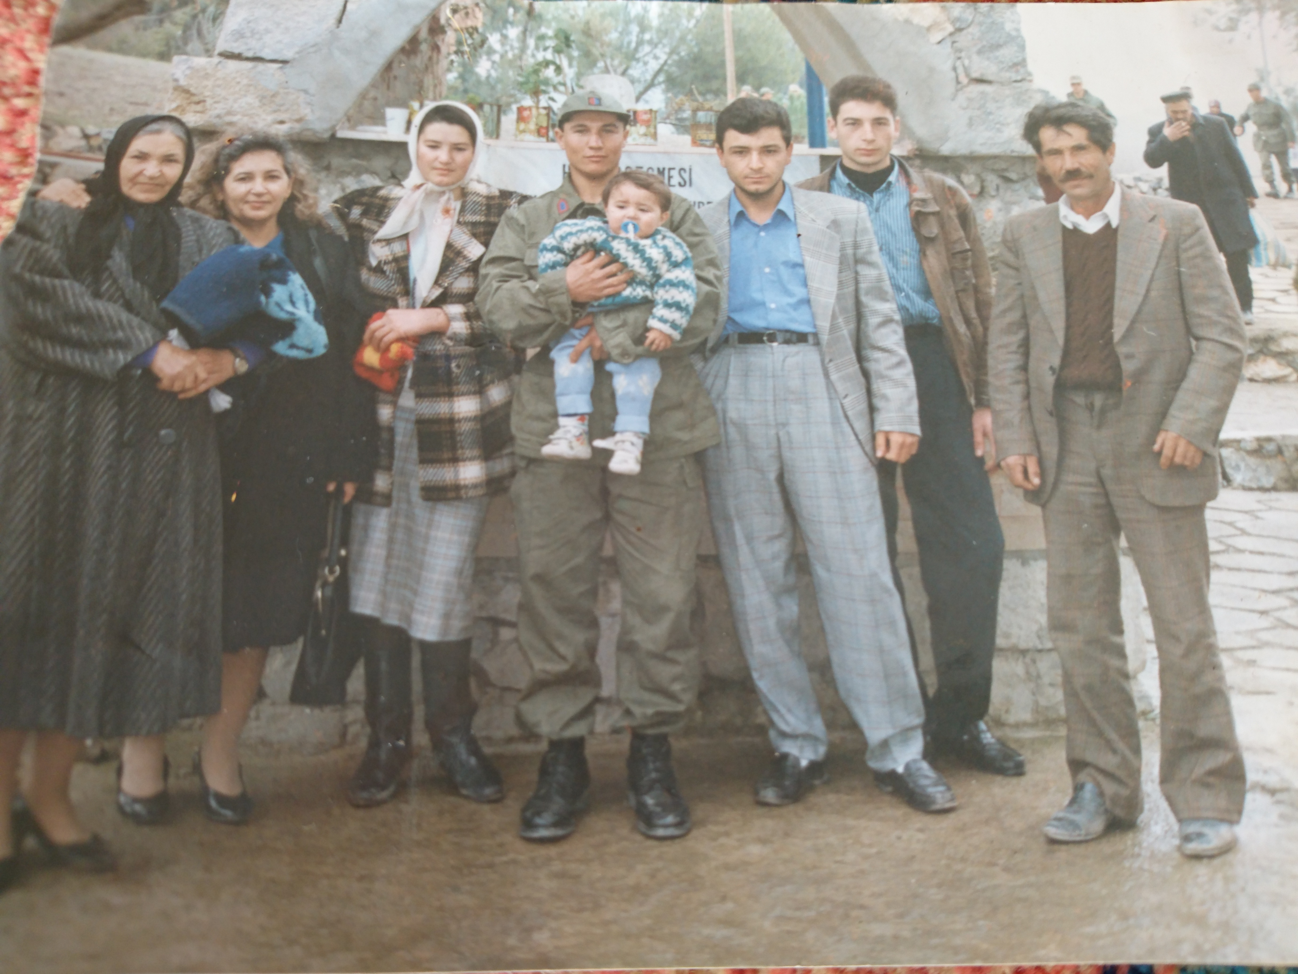

Slide 5
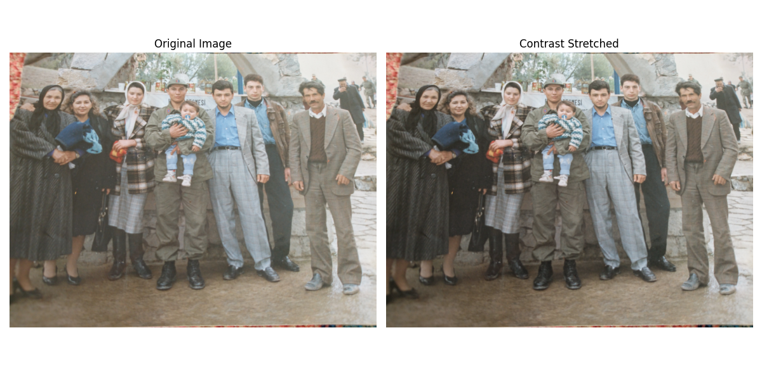
Contrast Stretching

Slide 6
Gamma Correction
s = c r^γ on V channel

Slide 7
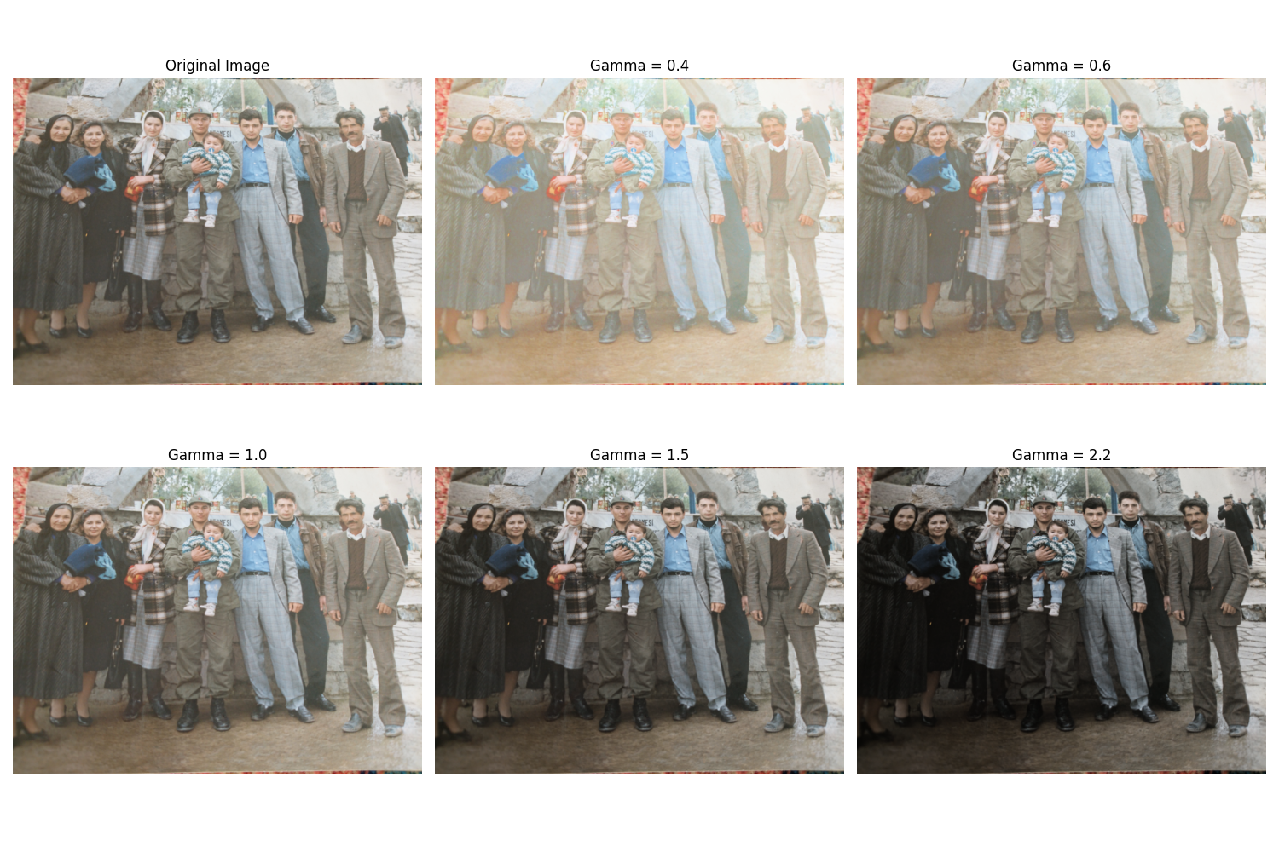
Gamma Correction Results

Slide 8
Histogram Equalization
Equalizing V channel in HSV

Slide 9
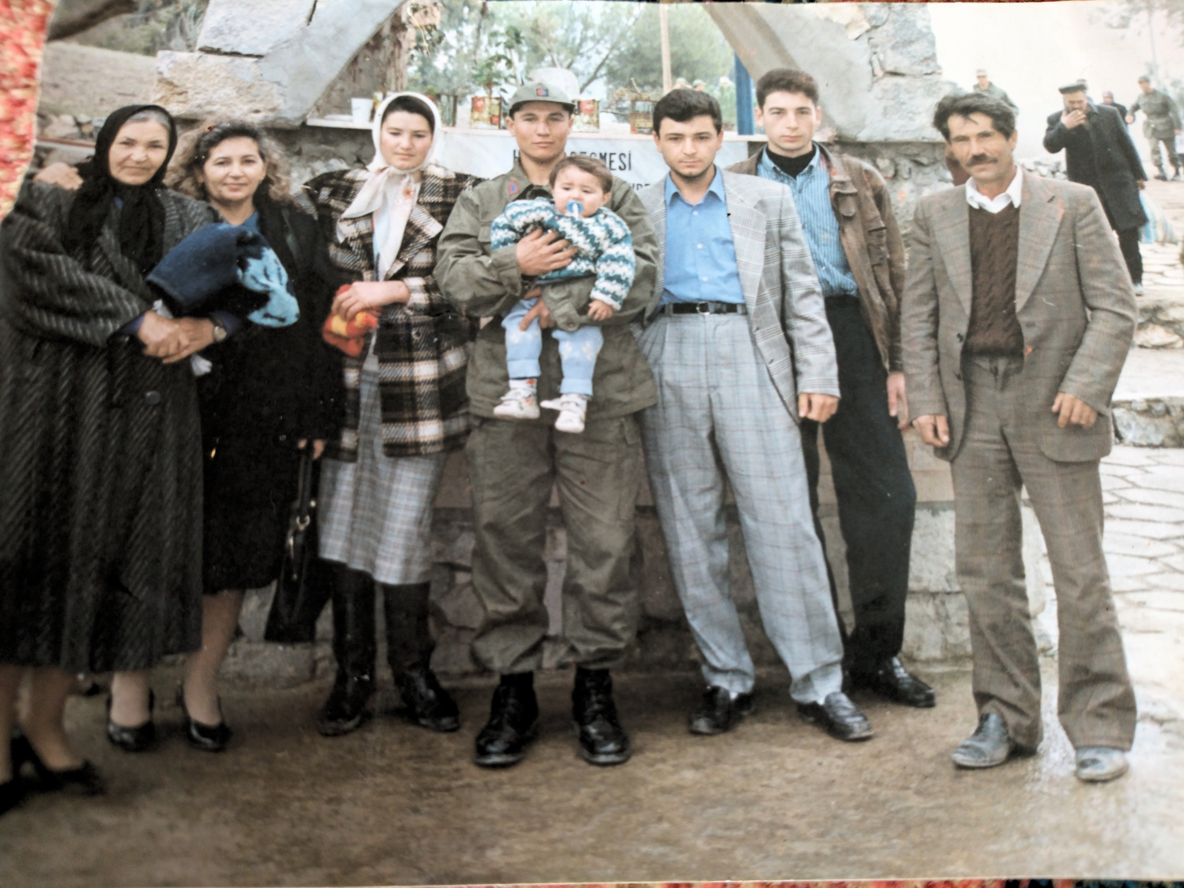
Histogram Equalization Analysis

Slide 10
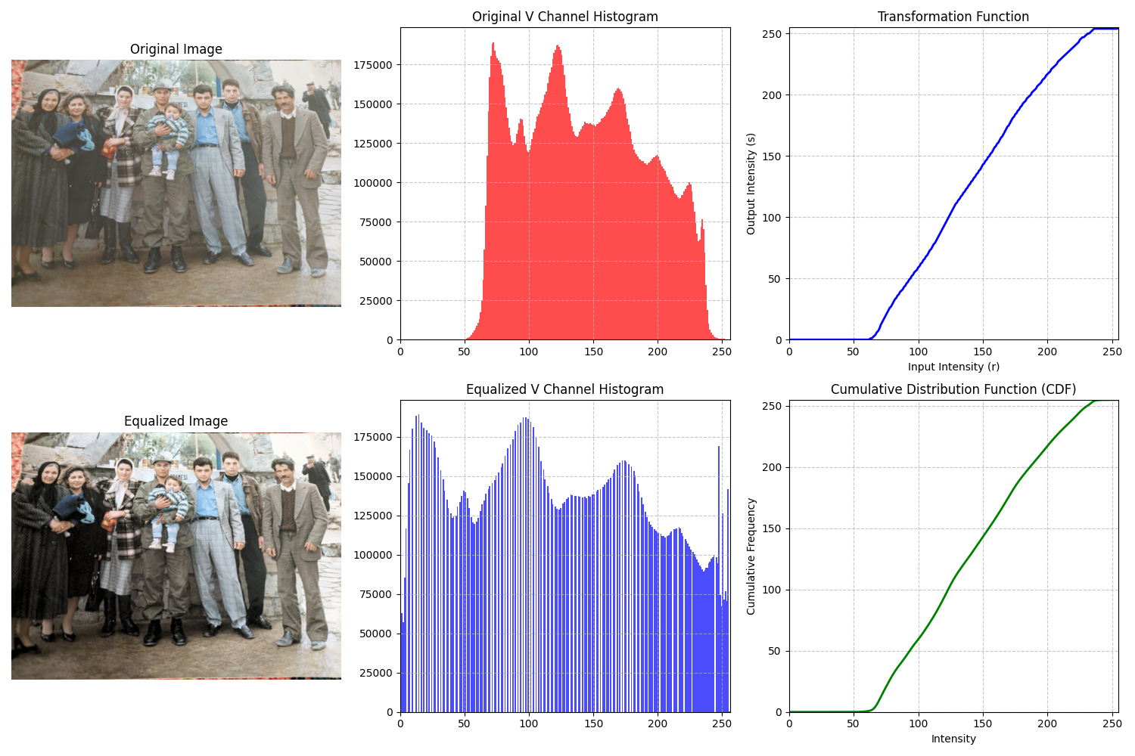

Slide 11
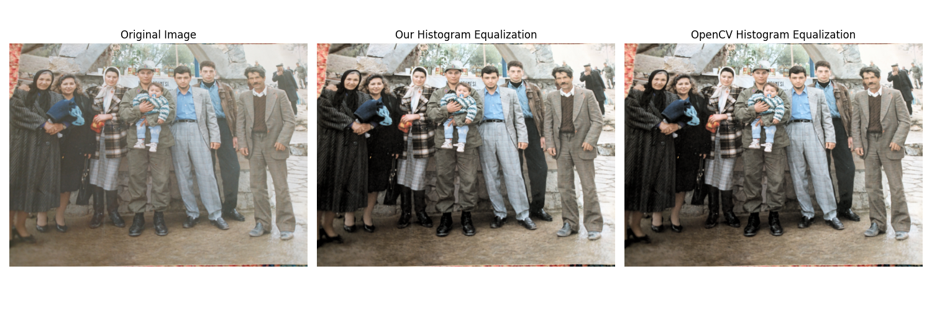

Slide 12
Histogram Distance
D1 distance on V channel histograms

Slide 13
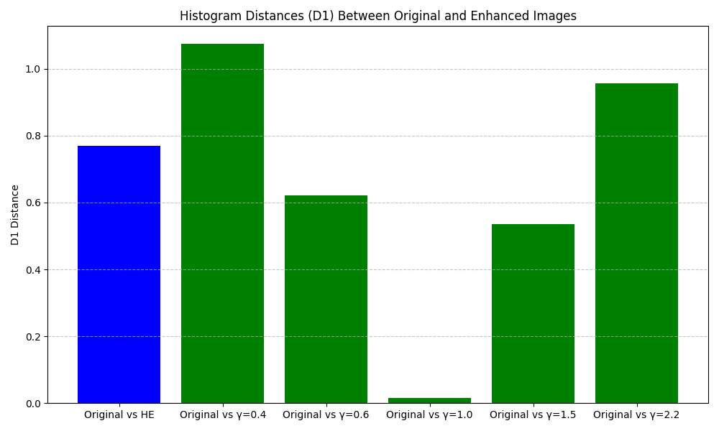
D1 Histogram Distance Measurements:
Original vs Histogram Equalization: 0.7699
Original vs Gamma=0.4: 1.0736
Original vs Gamma=0.6: 0.6202
Original vs Gamma=1.0: 0.0146
Original vs Gamma=1.5: 0.5346
Original vs Gamma=2.2: 0.9568

Slide 14
Conclusions
Key Findings:
Spatial domain enhancements can significantly improve image quality
HSV color space provides better results for color preservation
Each technique has specific strengths and applications
Quantitative comparison via histogram distance helps evaluate transformations
Applications:
Contrast stretching: Best for low-contrast images needing full-range expansion
Gamma correction: Ideal for targeted brightness adjustment in specific tonal regions
Histogram equalization: Effective for improving overall contrast distribution
Combined approach: Best results often come from applying multiple techniques

Slide 15
Thank You
Umut Celik
ID: 24654493
CSC 475: Image Processing
Homework 2: Image Enhancement
GitHub: https://github.com/umutcelik/image-processing-hw2
Based on lecture slides by Prof. Sos Agaian (CSI/CUNY)

